Slide 1
Logical Agents
Fundamentals of Artificial Intelligence
Slides are mostly adapted from AIMA and MIT Open Courseware

Slide 2
Outline
Knowledge-based agents
Wumpus world
Logic in general - models and entailment
Propositional (Boolean) logic
Equivalence, validity, satisfiability
Inference rules and theorem proving
  Resolution
  forward chaining
  backward chaining

Slide 3
Propositional logic: Syntax
Propositional logic is the simplest logic – illustrates basic ideas
Atomic sentences : consists of
  logical constants True and False
  proposition symbols P₁, P₂
Complex sentences : constructed from atomic sentences using logical connectives ¬, ∧ , ∨, ⇒, ⇔ and parentheses
  If S is a sentence, ¬S is a sentence (negation)
  If S₁ and S₂ are sentences, S₁ ∧ S₂ is a sentence (conjunction)
  If S₁ and S₂ are sentences, S₁ ∨ S₂ is a sentence (disjunction)
  If S₁ and S₂ are sentences, S₁ ⇒ S₂ is a sentence (implication)
  If S₁ and S₂ are sentences, S₁ ⇔ S₂ is a sentence (biconditional, equivalence)
Notes:
Despite its limited expressiveness propositional logic serves to illustrate many of the concepts in logic.
The syntax of propositional logic is simple.
The symbols of propositional logic are:
Logical constants : True and false
Proposition symbols such as P and Q
And the logical connectives
All sentences are made by putting these symbols using some rules
-the logical constants True and false are sentences by themselves
A propositional symbol such as p or Q is a sentence by itself
Wrapping parentheses around a sentence yields a sentence for example (P v Q )
A sentence can be formed by combining simpler sentences with one of the five logical connectives.
Not symbol is used for negation
The term literal is used meaning either an atomic sentence or a negated atomic sentence
A sentence that uses and symbol is called as a conjunction
A sentence that uses or symbol is called as disjunction
In implication or conditional left hand side is the premise or antecedent and right side is conclusion or consequent
Biconditional is also called as equivalence

Slide 4
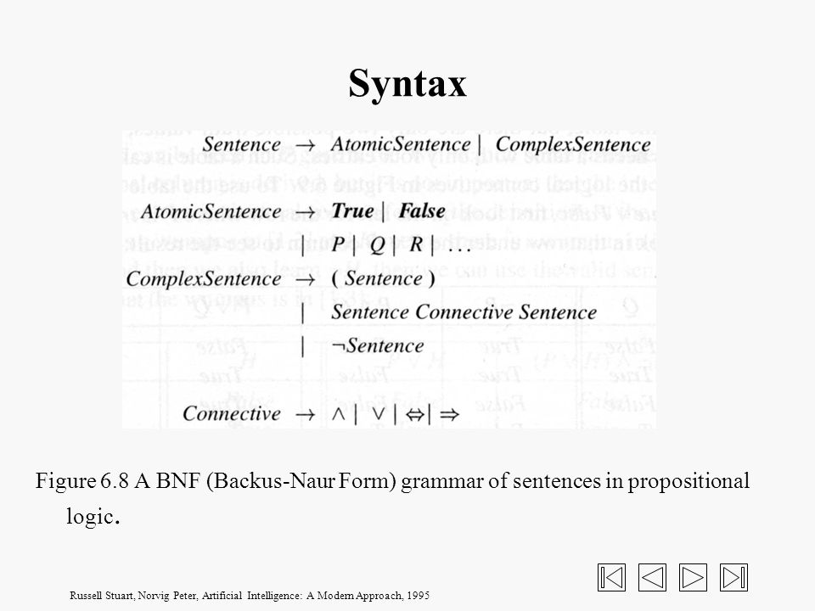
Notes:
We can now define the BNF notation for propositional logic.

Slide 5
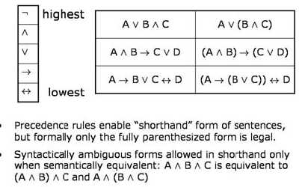
Precedence
  Use parentheses to specify the precedence
  Otherwise the precedence from highest to lowest is: ¬ , ∧, ∨, ⇒ , ⇔
  A ⇒ Β ⇒ C is not allowed
Notes:
As in arithmetic expressions we handle the ambiguity by the precedence rules.
Not has the highest precedence. It is followed by and, or and implies.
Biconditional comes the last.
Parantheses have always the highest precedence, and in formal representation only the fully parenthesized forms are legal
During the lectures we may eliminate the parantheses in sentences like A V B V C
But note that A -> b -> C is not allowed

Slide 6
Propositional logic: Semantics
Semantics defines the rules for determining the truth of a sentence with respect to a particular model
Each model specifies true/false for each proposition symbol
  E.g. P_{1,2} P_{2,2} P_{3,1}
  false true false
True is true in every model, False is false in every model
The truth value of every other proposition symbol must be specified directly in the model
For the complex sentences
Rules for evaluating truth with respect to a model m:
¬S is true iff S is false
S₁ ∧ S₂ is true iff S₁ is true and S₂ is true
S₁ ∨ S₂ is true iff S₁is true or S₂ is true
S₁ ⇒ S₂ is true iff S₁ is false or S₂ is true
i.e., is false iff S₁ is true and S₂ is false
S₁ ⇔ S₂ is true iff S₁⇒S₂ is true and S₂⇒S₁ is true
Notes:
The semantics of propositional logic is also straightforward
A proposition symbol can mean whatever you want.
The interpretation of P might be the fact that “Paris is the capital of France” or “the Wumpus is dead”
A sentence containing just a proposition symbol is satisfiable but not valid
True is always true
False is always false
A complex sentence has a meaning derived from the meaning of its parts.
The connectives not, or, and has easy to understand meanings

Slide 7

Truth tables for connectives
Most sentences are sometimes true:
e.g. P ∧ Q
Some sentences are always true (valid)
e.g. ¬ P ∨ P
Some sentences are never true (unsatisfiable)
e.g. ¬ P ∧ P
Notes:
Truth tables define the semantics of sentences
Now, let’s look at the table to derive the meaning of complex sentences constructed by a single connective.
Truth tables can be used not only to define the connectives, but also to find the truth values of complex sentences
Given a sentence we make a truth table with one row for each of the possible combinations of truth values for the proposition symbols in the sentence
Most sentences are sometimes true:
e.g. P and Q
Some sentences are always true (valid)
e.g. νοτ P ορ P
Some sentences are never true (unsatisfiable)
e.g. νοτ P ανδ P
If the sentence is true in every row , then the sentence is valid.
If the sentence is false in every row , then the sentence is unsatisfiable.

Slide 8
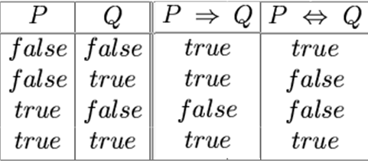

Implication and Biconditional
Implication: if P is true then I am claming that Q is true, otherwise I am making no claim
The sentence is false, if P is true but Q is false
P => Q is equivalent to ~P V Q
Pigs_Fly => EveryOneGetsAnA
Biconditional: True whenever both P->Q and Q->P is true
(e.g. a square is breezy if and only if adjacent square has a pit: implication requires the presence of pit if there is a breeze, biconditional also requires the absence of pit if there is no breeze)
Notes:
Implication: if P is true then I am claiming that Q is true, otherwise I am making no claim
The sentence is false, if P is true but Q is false
P -> q is equivalent to not p or Q
Under this definition the following statement is true
Pigs fly -> everyone gets an A
Since pigs fly is false, the statement is true irrespective of the truth of “everyone gets and A”
Biconditional: True whenever both P->Q and Q->P is true
(e.g. a square is breezy if and only if adjacent square has a pit: implication requires the presence of pit if there is a breeze, biconditional also requires the absence of pit if there is no breeze)

Slide 9
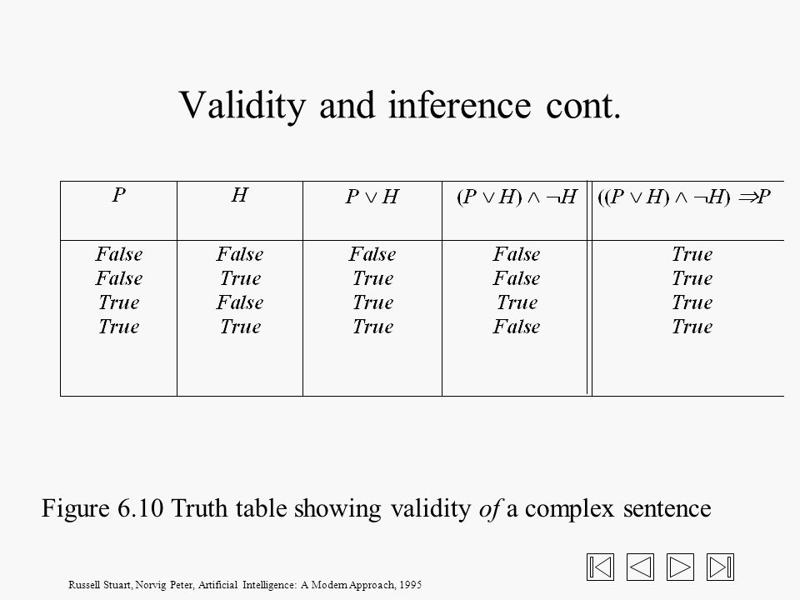
Validity and Inference
Notes:
Let’s now consider more complex sentences
Given a sentence we make a truth table with one row for each of the possible combinations of truth values for the proposition symbols in the sentence
If the sentence is true in every row , then the sentence is valid.
For example here The sentence ( ( P or H) and not H) implies P is valid
Suppose P means that there is a wumpus in [1,3]
And H means that there is a wumpus in [2,2]
If at some point we learn p or H and then we also learn not H,
Then we can use the valid sentence to conclude that P is true
That is the wumpus is in [1,3]

Slide 10
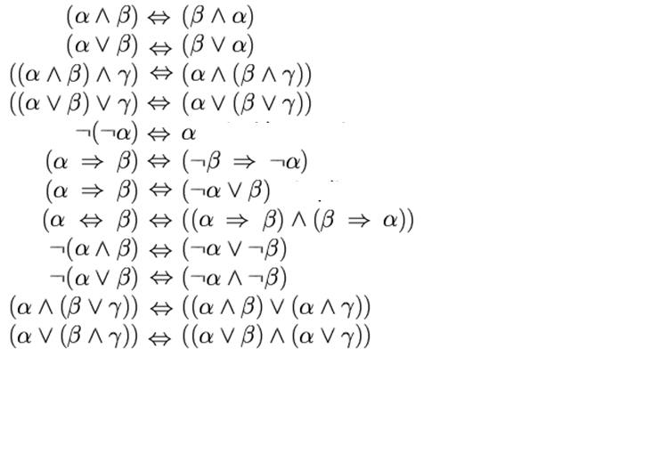
Logical equivalence
Notes:
We can use the truth tables to show that these sentences are valid

Slide 11

Logical equivalence
Two sentences are logically equivalent iff they are true in same models:
α ≡ ß iff α╞ β and β╞ α
Notes:
We can now change the biconditional sign with equivalence
We can say that two sentences are equivalent if their truth values are the same in all models.
For some of the equivalence rules there are standard names

Slide 12
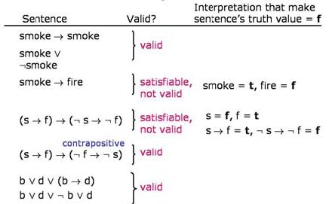
Examples
Notes:
Let’s see more examples

Slide 13
Satisfiability
Related to constraint satisfaction
Given a sentence S, try to find an interpretation i where S is true
Analogous to finding an assignment of values to variables such that the constraint hold
Example problem: scheduling nurses in a hospital
  Propositional variables represent for example that Nurse1 is working on Tuesday at 2
  Constraints on the schedule are represented using logical expressions over the variables
Brute force method: enumerate all interpretations and check
Notes:
Here, note that satisfiability is related to constraint satisfaction
Given a sentence S, we try to find an interpretation i where S is true
This is analogous to finding an assignment of values to variables such that the constraint hold
The brute force strategy is to enumerate all interpretations and check

Slide 14

Wumpus world sentences
Let P_{i,j} be true if there is a pit in [i, j].
Let B_{i,j} be true if there is a breeze in [i, j].
Knowledge base includes:
  R1: ¬ P_{1,1} No pit in [1,1]
  R2: ¬B_{1,1} No breeze in [1.1]
  R3: B_{2,1} Breeze in [2,1]
"Pits cause breezes in adjacent squares"
  R4: B_{1,1} ⇔ (P_{1,2} ∨ P_{2,1})
  R5: B_{2,1} ⇔ (P_{1,1} ∨ P_{2,2} ∨ P_{3,1})
KB = R1 ∧ R2 ∧ R3 ∧ R4 ∧ R5
Notes:
Let’s now try to represent the Wumpus world in propositional logic
Assume that Pi.j means that “there is a pit in [i.j] and
Similarly B I,j means that “there is a breeze in [I,j]”
We can write our observations (facts),
such as no pit in in [1,1] and so on,
Or the rules about the world,
Such as
If there is a breeze in [1,1] then there is a pi either in [1,2] or [2,1]
In our example case, the knowledge base consists of conjunction of these 5 sentences

Slide 15

Truth tables for inference
  R1: ¬ P_{1,1}
  R2: ¬B_{1,1}
  R3: B_{2,1}
  R4: B_{1,1} ⇔ (P_{1,2} ∨ P_{2,1})
  R5: B_{2,1} ⇔ (P_{1,1} ∨ P_{2,2} ∨ P_{3,1})
  KB = R1 ∧ R2 ∧ R3 ∧ R4 ∧ R5
  α1 = ¬ P_{1,2}
  α2 = P_{2,2}
  α1 is true in all models that
  KB is true
  α2 is true only in
  two models that KB is true,
  but false in the other one
Decide whether KB╞ α
First method: enumerate the models and
check that α is true in every model
in which KB is true
B_{1,1} B_{2,1}, P_{1,1} , P_{1,2}, P_{2,1}, P_{2,2}, P_{3,1}
7 symbols : 2⁷ = 128 possible models
Notes:
Recall that a sentence alpha is entailed by a knowledge base KB if the models of KB are all models of alpha
If this is the case, then whenever KB is true alpha must be true.
Let’s consider two sentences alpha1 and alpha2
Alpha1 states that there is no pit in [1,2]
Alpha2 states that there is a pit in [2,2]
As you see from the truth table alpha1 is true in all the models where KB is true
On the other hand alpha2 is false in some models where KB is true

Slide 16

Inference by enumeration
Depth-first enumeration of all models is sound and complete
For n symbols, time complexity is O(2^{n}), space complexity is O(n)
Notes:
We can now write the complete inference algorithm by enumeration
Note that, Depth-first enumeration of all models is sound and complete
For n symbols, time complexity is O(2^{n}), space complexity is O(n)

Slide 17
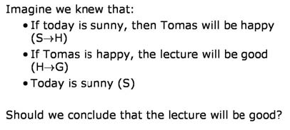
Example Problem
Notes:
Let’s consider another example
We have two rules and one fact in our KB
If today is happy then Thomas will be happy
If Thomas is happy the lecture will be good
Today is sunny
Let’s S be represent “today is sunny”
H “Thomas will be happy”
And
G “The lecture will be good”
So that we can write Kb in propositional logic as
S->H
H->G
S
Should be conclude about G?
So alpha is G

Slide 18

Checking Interpretations
Start by figuring out what set of interpretations make our original sentences true.
Then, if G is true in all those interpretations, it must be OK to conclude it from the sentences we started out with (our knowledge base).
In a universe with only three variables, there are 8 possible interpretations in total.
Notes:
What should we do.
We will enumarete , and see if alpha is true in all models where KB is true
Then we can conclude that KB entails alpha
Or alpha follows from KB
In this example, there are three propositional variables and therefore the size of the table is 2^3 = 8

Slide 19
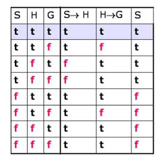
Checking Interpretations
Only one of these interpretations makes all the sentences in our knowledge base true:
S = true, H = true, G = true.
Notes:
Only one of these interpretations makes all the sentences in our knowledge base true:
S = true, H = true, G = true.

Slide 20
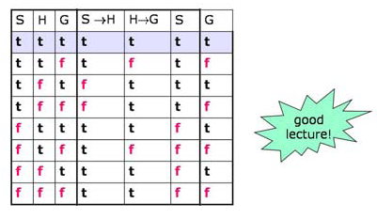
Checking Interpretations
it's easy enough to check that G is true in that interpretation, so it seems like it must be reasonable to draw the conclusion that the lecture will be good.
Notes:
it's easy enough to check that G is true in that interpretation, so it seems like it must be reasonable to draw the conclusion that the lecture will be good.

Slide 21
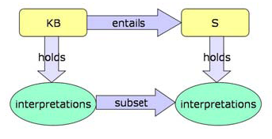


Computing entailment
Model checking
Truth table enumeration (sound and complete for propositional logic)
For n symbols the time complexity is O(2^n)
Need a smarter way to do inference
Notes:
Upto now, in order to show that
“A knowledge base entails a sentence iff every interpretation that makes KB true also makes S true”
We have enumerated all the interpretations
And
Selected those in which all elements of KB are true
Then we checked to see if S is true in all of those interporetations
Model checking through
Truth table enumeration is sound and complete for propositional logic
The truth table method of inference is complete because it is always possible to enumerate the 2^n rows of the table for any proof involving n proposition symbols
However the computation time is exponential in n (For n symbols the time complexity is O(2^n)
) and thus not very practical
Weneed a smarter way to do inference

Slide 22
Validity and Inference
premises ⇒ conclusion
Notes:
Let’s consider the example again
This conclusion is important
It says that if we have some premises and a possible conclusion, we can determine if the conclusion is true.
We can do this by building a truth table for the sentence
premises -> conclusion
And checking all the rows
If every row is true then the conclusion is entailed by the premises
Which means that the fact represented by the conclusion follows from the premises

Slide 23
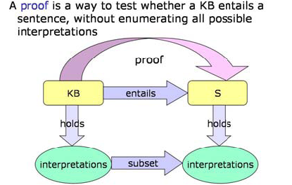
Entailment and Proof
Notes:
An alternative to model checking is the Application of inference rules
for Legitimate (sound) generation of new sentences from old
Proof is a sequence of inference rule applications
It is a way to test whether a KB entails a sentence without enumerating all possible interpretations

Slide 24
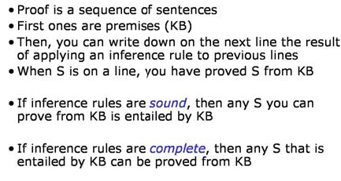
Proof

Slide 25
Rules of ınference
Recall that
KB ├_{i} α = sentence α can be derived from KB by a procedure i (an inference algorithm)
If we generalize it to any two sentences α and β
α ├ β means that β is derived from α by an inference
The alternative notation:
α premise
β conclusion
Notes:
Recall that
KB ├_{i} α represents that, sentence α can be derived from KB by a procedure i (an inference algorithm)
If we generalize it to any two sentences α and β
α ├ β means that β is derived from α by an inference
Whenever something in the knowledge base matches the pattern above the line,
The inference rule concludes the premise below the line.
Alpha and beta can match any sentence, not just the proposition symbols. If there are several sentences they are separated by columns.

Slide 26
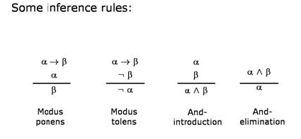
Some inference rules
Notes:
Some inference rules are as shown here

Slide 27
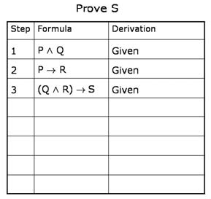
Example

Slide 28
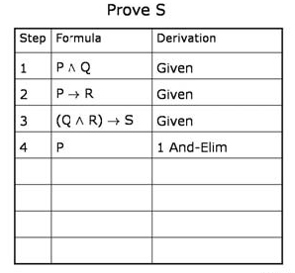
Example

Slide 29
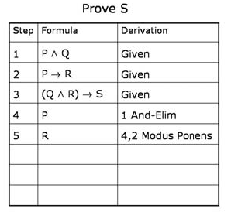
Example

Slide 30
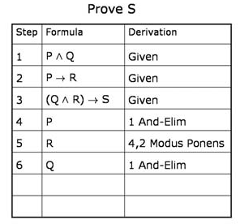
Example

Slide 31
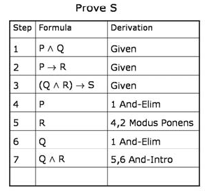
Example

Slide 32
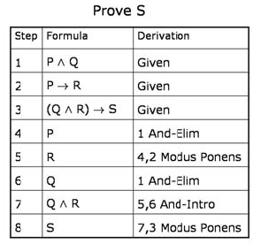
Example

Slide 33
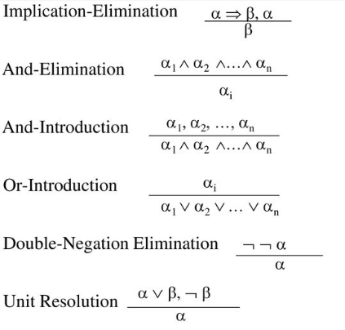
Notes:
Let’s consider the inference rules for propositional logic:
Modus ponens or implication elimination means that from an implication and the premise of that implication you can infer the conclusion
And elimination means that from a conjunction you can infer any of the conjuncts
And introduction means that from a list of sentences you can infer the conjunction.
Or introduction means that from a sentence you can infer its disjunction with anything else at all.
Double negation elimination means that from a doubly negated sentence you can infer a positive sentence
Unit resolution means that from a disjunction if one of the disjuncts is false then you can infer the other one is true.

Slide 34
Logical equivalence
Notes:
Remember the logical equivalence rules that we have defined
Now, we will also make use of them to convert our sentences into some equivalent forms for which it is easier to apply the inference rules

Slide 35
Example from Wumpus World
  R1: ¬ P_{1,1}
  R2: ¬B_{1,1}
  R3: B_{2,1}
  R4: B_{1,1} ⇔ (P_{1,2} ∨ P_{2,1})
  R5: B_{2,1} ⇔ (P_{1,1} ∨ P_{2,2} ∨ P_{3,1})
  KB = R1 ∧ R2 ∧ R3 ∧ R4 ∧ R5
  Prove α1 = ¬ P_{1,2}
Notes:
Let’s consider the wumpus world again

Slide 36
Example from Wumpus World
  R1: ¬ P_{1,1}
  R2: ¬B_{1,1}
  R3: B_{2,1}
  R4: B_{1,1} ⇔ (P_{1,2} ∨ P_{2,1})
  R5: B_{2,1} ⇔ (P_{1,1} ∨ P_{2,2} ∨ P_{3,1})
  R6 : B_{1,1} ⇔ (B_{1,1} ⇒ (P_{1,2} ∨ P_{2,1})) ∧((P_{1,2} ∨ P_{2,1}) ⇒ B_{1,1}) Biconditional elimination

Slide 37
Example from Wumpus World
  R1: ¬ P_{1,1}
  R2: ¬B_{1,1}
  R3: B_{2,1}
  R4: B_{1,1} ⇔ (P_{1,2} ∨ P_{2,1})
  R5: B_{2,1} ⇔ (P_{1,1} ∨ P_{2,2} ∨ P_{3,1})
  R6 : B_{1,1} ⇔ (B_{1,1} ⇒ (P_{1,2} ∨ P_{2,1})) ∧((P_{1,2} ∨ P_{2,1}) ⇒ B_{1,1}) Biconditional elimination
  R7 : ((P_{1,2} ∨ P_{2,1}) ⇒ B_{1,1}) And Elimination

Slide 38
Example from Wumpus World
  R1: ¬ P_{1,1}
  R2: ¬B_{1,1}
  R3: B_{2,1}
  R4: B_{1,1} ⇔ (P_{1,2} ∨ P_{2,1})
  R5: B_{2,1} ⇔ (P_{1,1} ∨ P_{2,2} ∨ P_{3,1})
  R6 : B_{1,1} ⇔ (B_{1,1} ⇒ (P_{1,2} ∨ P_{2,1})) ∧((P_{1,2} ∨ P_{2,1}) ⇒ B_{1,1}) Biconditional elimination
  R7 : ((P_{1,2} ∨ P_{2,1}) ⇒ B_{1,1}) And Elimination
  R8: (¬ B_{1,1} ⇒ ¬ (P_{1,2} ∨ P_{2,1})) Equivalence for contrapositives

Slide 39
Example from Wumpus World
  R1: ¬ P_{1,1}
  R2: ¬B_{1,1}
  R3: B_{2,1}
  R4: B_{1,1} ⇔ (P_{1,2} ∨ P_{2,1})
  R5: B_{2,1} ⇔ (P_{1,1} ∨ P_{2,2} ∨ P_{3,1})
  R6 : B_{1,1} ⇔ (B_{1,1} ⇒ (P_{1,2} ∨ P_{2,1})) ∧((P_{1,2} ∨ P_{2,1}) ⇒ B_{1,1}) Biconditional elimination
  R7 : ((P_{1,2} ∨ P_{2,1}) ⇒ B_{1,1}) And Elimination
  R8: (¬ B_{1,1} ⇒ ¬ (P_{1,2} ∨ P_{2,1})) Equivalence for contrapositives
  R9: ¬ (P_{1,2} ∨ P_{2,1}) Modus Ponens with R2 and R8

Slide 40
Example from Wumpus World
  R1: ¬ P_{1,1}
  R2: ¬B_{1,1}
  R3: B_{2,1}
  R4: B_{1,1} ⇔ (P_{1,2} ∨ P_{2,1})
  R5: B_{2,1} ⇔ (P_{1,1} ∨ P_{2,2} ∨ P_{3,1})
  R6 : B_{1,1} ⇔ (B_{1,1} ⇒ (P_{1,2} ∨ P_{2,1})) ∧((P_{1,2} ∨ P_{2,1}) ⇒ B_{1,1}) Biconditional elimination
  R7 : ((P_{1,2} ∨ P_{2,1}) ⇒ B_{1,1}) And Elimination
  R8: (¬ B_{1,1} ⇒ ¬ (P_{1,2} ∨ P_{2,1})) Equivalence for contrapositives
  R9: ¬ (P_{1,2} ∨ P_{2,1}) Modus Ponens with R2 and R8
  R10: ¬ P_{1,2} ∧ ¬ P_{2,1} De Morgan’s Rule

Slide 41
Example from Wumpus World
  R1: ¬ P_{1,1}
  R2: ¬B_{1,1}
  R3: B_{2,1}
  R4: B_{1,1} ⇔ (P_{1,2} ∨ P_{2,1})
  R5: B_{2,1} ⇔ (P_{1,1} ∨ P_{2,2} ∨ P_{3,1})
  R6 : B_{1,1} ⇔ (B_{1,1} ⇒ (P_{1,2} ∨ P_{2,1})) ∧((P_{1,2} ∨ P_{2,1}) ⇒ B_{1,1}) Biconditional elimination
  R7 : ((P_{1,2} ∨ P_{2,1}) ⇒ B_{1,1}) And Elimination
  R8: (¬ B_{1,1} ⇒ ¬ (P_{1,2} ∨ P_{2,1})) Equivalence for contrapositives
  R9: ¬ (P_{1,2} ∨ P_{2,1}) Modus Ponens with R2 and R8
  R10: ¬ P_{1,2} ∧ ¬ P_{2,1} De Morgan’s Rule
  R11: ¬ P_{1,2} And Elimination

Slide 42
Monotonicity
The set of entailed sentences can only increase as information is added to the knowledge base
If
KB╞ α
Then
KB ∧ β╞ α
Notes:
The use of inference rules to draw conclusions from a knowledge base relies implicitly on a general property of certain logics called monotonicity
Suppose that a knowledge base entails some set of sentences.
A logic is monotonic if when we add some new sentences to the knowledge base,
all sentences entailed by the original KB are still entailed by the new larger knowledge base
This is regardless of the content of beta

